Slide 1
ĐOÀN PHƯỜNG 13 QUẬN 5
CHI ĐOÀN LÊ ĐÌNH CHINH
Chào mừng Đại hội đại biểu
Đoàn TNCS Hồ Chí Minh Phường 13 Quận 5
Lần thứ XI, Nhiệm kỳ 2022 - 2027
Đoàn viên thực hiện:
Môn :
Lớp :
NGUYỄN THỤY VÂN AN
Tiếng Anh
4

Slide 3
Unit 4
Lesson Two
Grammar

Slide 5
Warm up

Slide 6
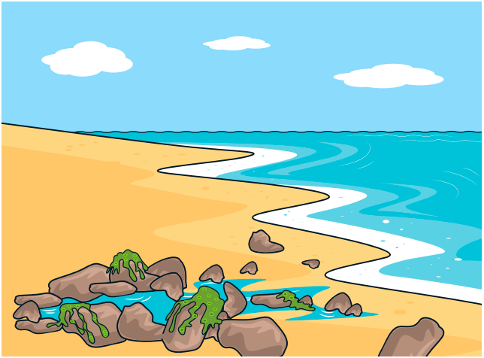
Listen and repeat.
beach
sail
surf
kayak
windsurf
snorkel
waterski

Slide 7
New lesson

Slide 8
Listen to the story.

Slide 9
2. Look and say.

Slide 10
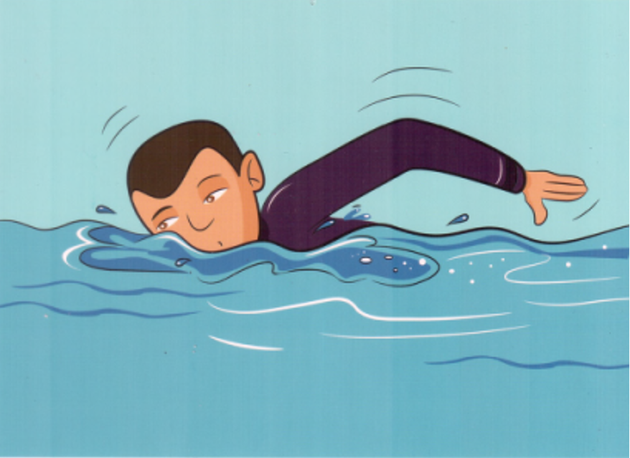
PRESENT CONTINUOUS
What is he doing?
What is she doing?
He is swimming.
She is sailing.

Slide 12
Subject+ be (am, is, are) + verb-ing

Slide 13
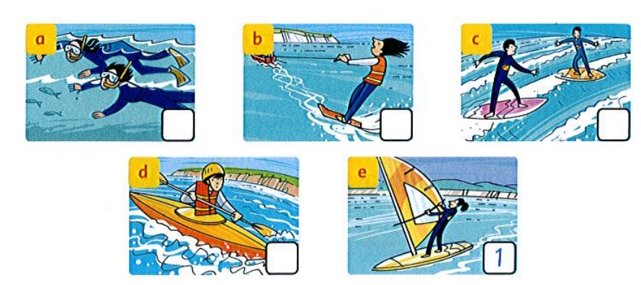
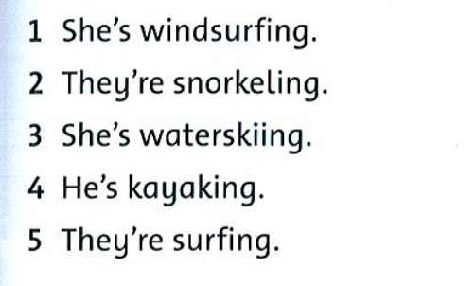
3. Read and write the number.
2
3
5
4

Slide 14
4. Write
‘re
aren’t
isn’t
aren’t
‘re
is

Slide 15
PRESENT CONTINUOUS
点击替换照片
点击替换照片
GAME
点击替换照片
Choose the right option.

Slide 16
Ken is…
GREAT
waterskiing
surfing
swimming

Slide 17
Jack is …
snorkeling
kayaking
surfing

Slide 18
John and Mark are …
windsurfing
sailing
kayaking

Slide 19
The girl is…
sailing
surfing
kayaking

Slide 20
P.29
Workbook time!!!

Slide 21
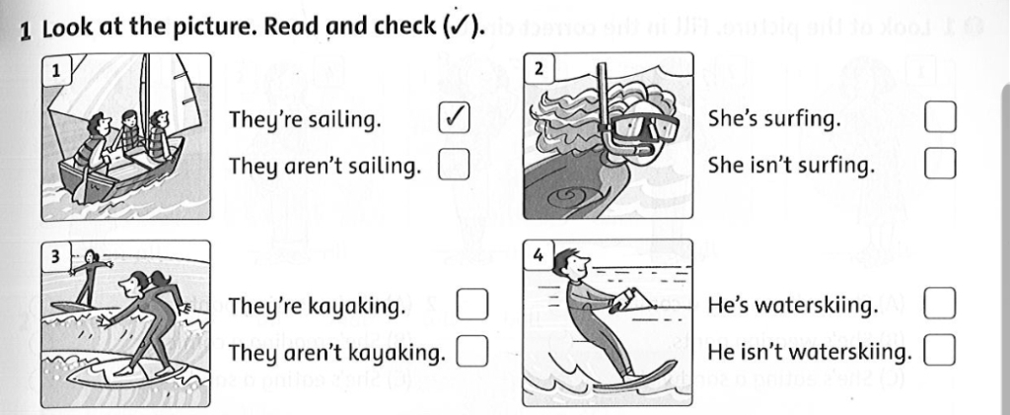




Slide 22
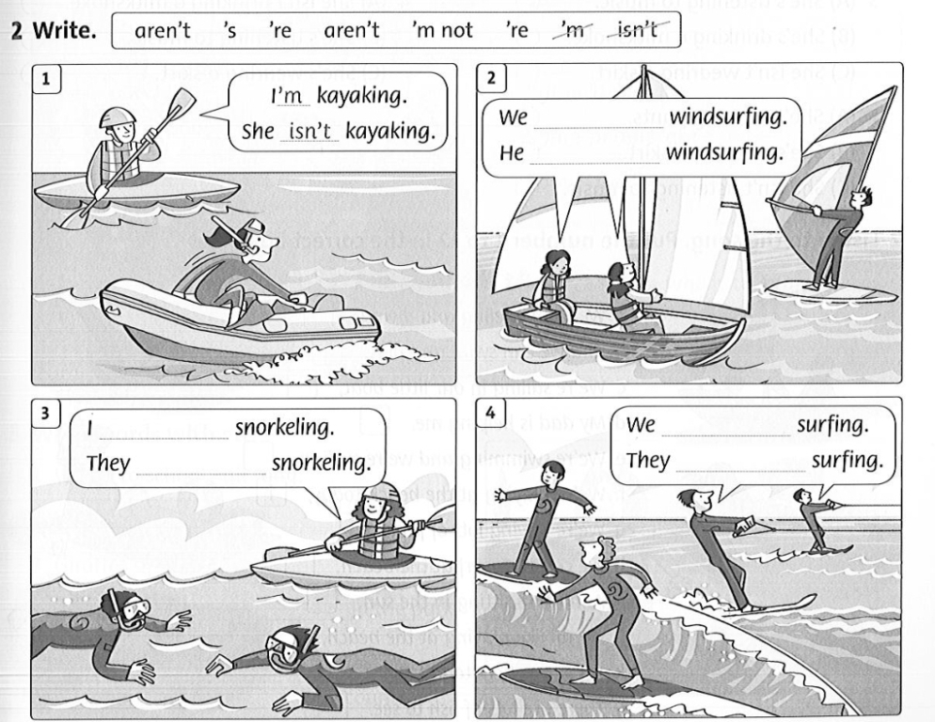
aren’t
’s
’m not
aren’t
’re
’re

Slide 23
Good bye

